Slide 1
MCA105-Operating System

Slide 2
Agenda
Files

Slide 3
What are files?
A file is a collection of related information (sequence of bits) that is recorded on secondary storage
File is a collection of logically related entities
From a user’s point of view, a file is the smallest allotment of logical secondary storage

Slide 4
File Concept
Uniform logical view of information storage (logical storage unit)
OS maps files onto physical devices
Collection of related information recorded on a secondary storage.
Smallest allotment of secondary storage Types:
Data
numeric
character
binary
Program

Slide 5
File Management
The main objectives of the file management system are:
It provides I/O support for a variety of storage device types.
Minimizes the chances of lost or destroyed data
It provides I/O support for multiple users in a multiuser systems environment.

Slide 6
Properties of a File System
The properties of a File System are:
Files are stored on disk or other storage and do not disappear when a user logs off.
Files have names and are associated with access permission that permits controlled sharing.
Files could be arranged or more complex structures to reflect the relationship between them.

Slide 7
File Operations
File is an abstract data type
Create
Write
Read
Reposition within file
Delete
Truncate

Slide 8
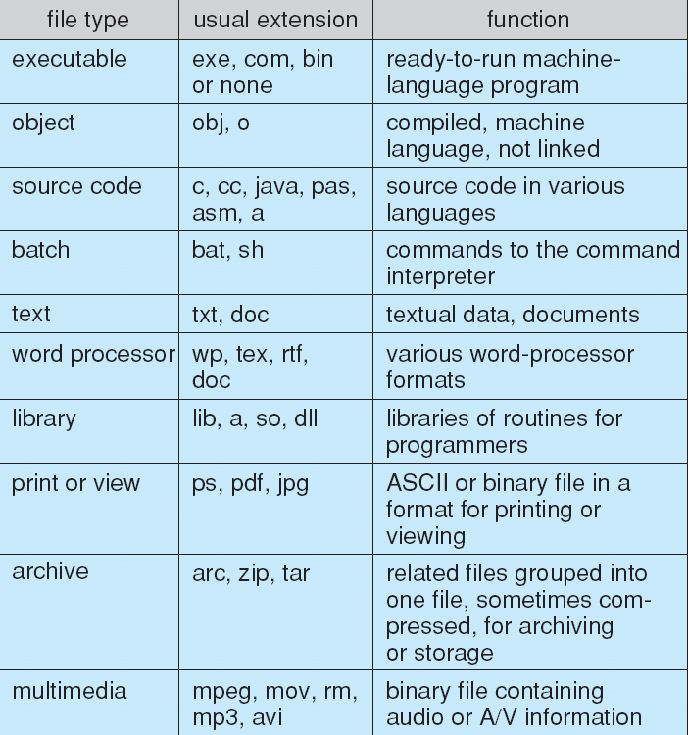
File Types – Name, Extension

Slide 9
Access Methods
Sequential Access
read next
write next
reset
Direct Access
read n
write n
position to n
read next
write next
rewrite n
n = relative block number

Slide 10
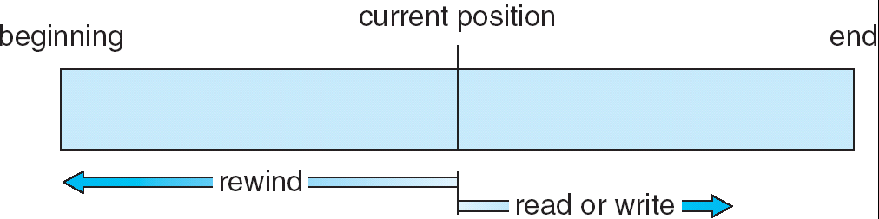
Sequential-access File

Slide 11
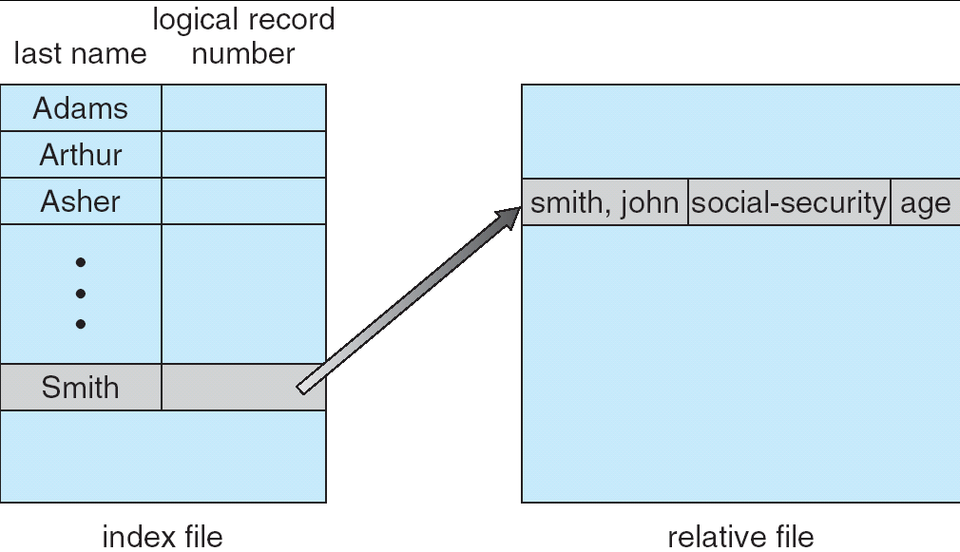
Index Access

Slide 12
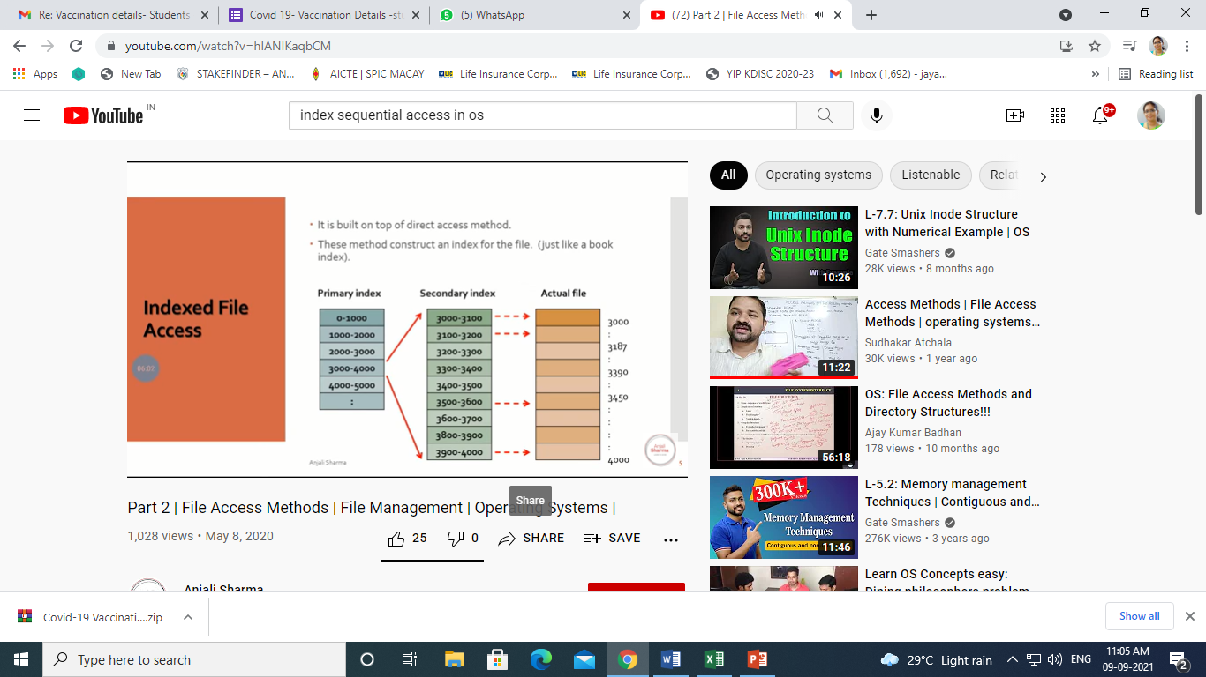

Slide 13
Directory Structure
A collection of nodes containing information about all files
Directory
Files
F 1
F 2
F 3
F 4
F n
Both the directory structure and the files reside on disk
Backups of these two structures are kept on tapes

Slide 14
Disk Structure
Disk can be subdivided into partitions
Disks or partitions can be RAID protected against failure
Disk or partition can be used raw – without a file system, or formatted with a file system
Partitions also known as minidisks, slices

Slide 15
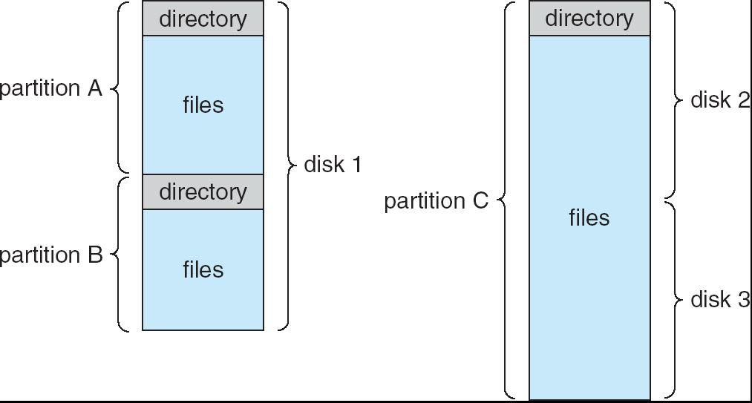
A Typical File-system Organization

Slide 16
Operations Performed on Directory
Search for a file
Create a file
Delete a file
List a directory
Rename a file
Traverse the file system

Slide 17
Directory Organization(Logically)
Efficiency – locating a file quickly
Naming – convenient to users
Two users can have same name for different files
The same file can have several different names
Grouping – logical grouping of files by properties, (e.g., all Java programs, all games, …)

Slide 18
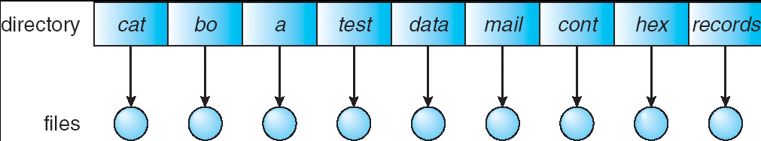
Single-Level Directory
A single directory for all users
Naming problem
Grouping problem

Slide 19
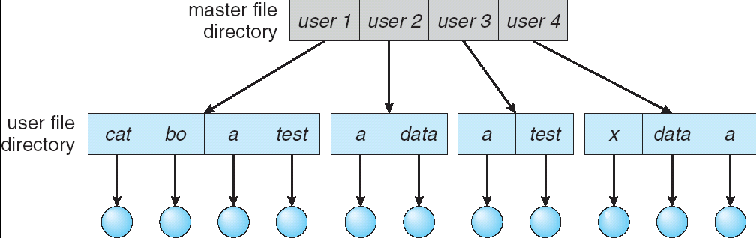
Two-Level Directory
Separate directory for each user
Can have the same file name for different user
Efficient searching
No grouping capability

Slide 20
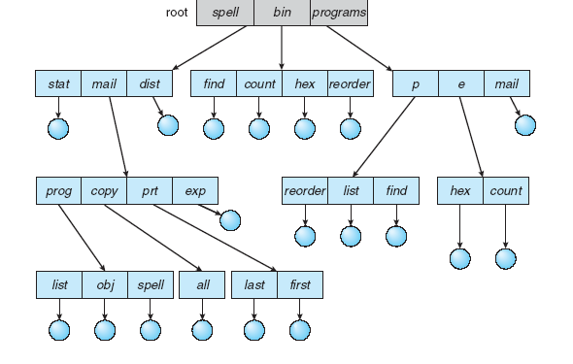
Tree-Structured Directories

Slide 21
Tree-Structured Directories (Cont)
Efficient searching
Grouping Capability
Current directory (working directory)

Slide 22
Tree-Structured Directories
Absolute or relative path name
Creating a new file is done in current directory
Delete a file
rm <file-name>
Creating a new subdirectory is done in current directory
mkdir <dir-name>
Example: if in current directory /mail
mkdir count
mail
prog
copy
prt
exp
count
Deleting “mail” ⇒ deleting the entire subtree rooted by “mail”

Slide 23
Tree-Structured Directories-Advantages
Tree-structure allows each user to create additional subdirectories
allows us to use the current directory as a working directory without the need to specify the whole path name
The deletion of a directory must be recursive to delete all subdirectories and files under the directory

Slide 24
Cons…
None of the above three directory structures enable sharing of files or subdirectories
Adding additional links can result in a general graph or an acyclic graph

Slide 25
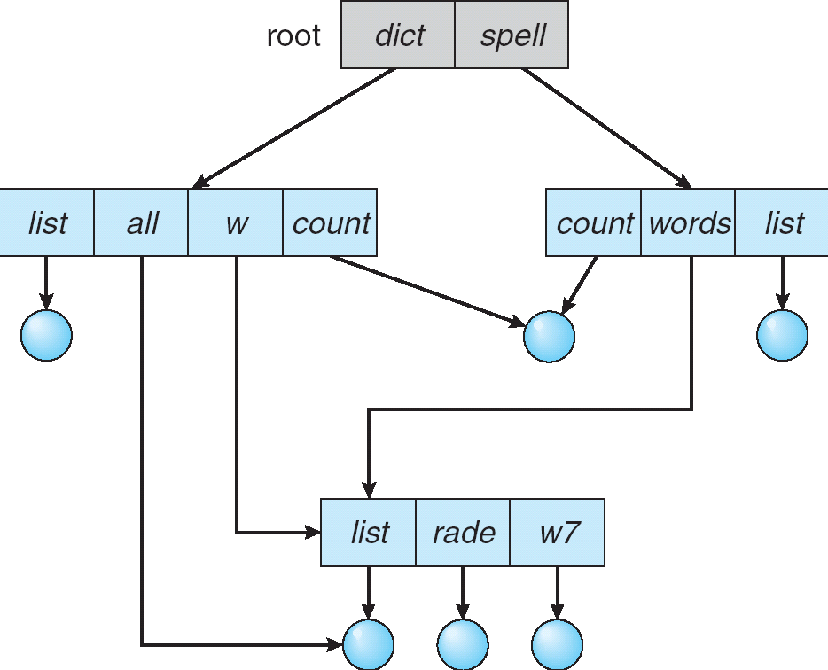
Acyclic-Graph Directories
Have shared subdirectories and files

Slide 26
Acyclic-Graph Directories (Cont.)
Two different names (aliasing)
Dangling pointer
Solutions:
Back pointers, so we can delete all pointers
Entry-hold-count solution
New directory entry type
Link – another name (pointer) to an existing file
Resolve the link – follow pointer to locate the file

Slide 27
Pros & Cons
Acyclic-graph approach enables sharing
The common implementation is to define a "link" as a pointer to another file or subdirectory
The link can be resolved by using the path name. File now can have more than one file names (distinct)

Slide 28
Pros & Cons
The deletion is complicated
since this might leave "dangling links", as the file itself could be deleted, yet the link pointing to it still exists
Or we have to track all the references to a file; unless there is no reference, the file can not be deleted
Notes:
Reference count if reference count is zero delete the file

Slide 29
THANK YOU

